Slide 1
Smart System for Visually Impaired
Team 29
Smart Bears
Lukas Chin, Jake Lee, Shamir Legaspi, Jason Li, David Li

Slide 2
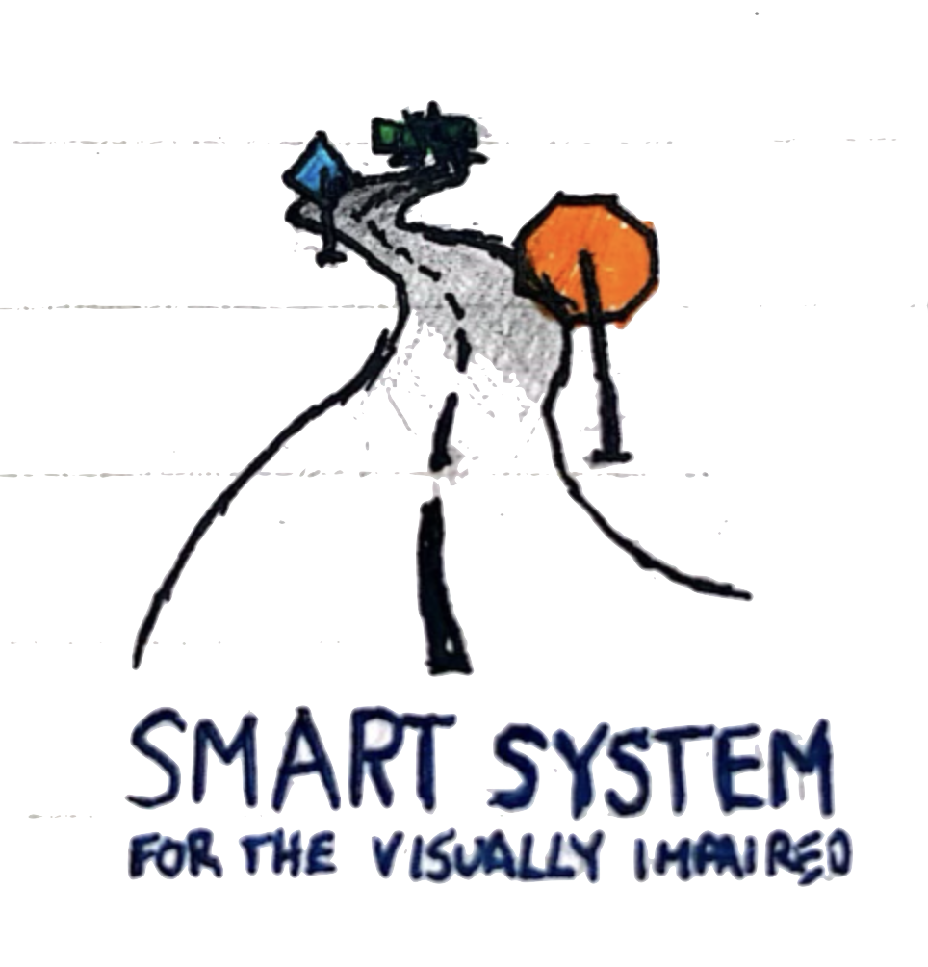
Introduction
Technical Progress
In Progress
Milestones

Slide 3
Introduction

Slide 4
Introduction
7.2 million Americans live with visual impairment or blindness, with numbers expected to double by 2050
20% of all people older than 85 experience permanent vision loss
Traditional aids like white canes and guide dogs provide limited information for safe mobility
Advanced wearable technologies can provide even greater assistance on top of these existing aids
Our Smart System combines wearable technology with cutting-edge computer vision to revolutionize navigation for the visually impaired
Featuring dual-component design—Smart Cap and Wrist-Wearable working wirelessly and simultaneously together
Notes:
So, for a quick introduction, 7.2 million Americans live with visual impairment or blindness, with numbers expected to double by 2050. Roughly 20% of all people older than 85 will experience some kind of permanent vision loss and current traditional aids such as white canes and guide dogs provide limited information for safe mobility. We believe that advanced wearable technology can provide even greater assistance on top of these existing aids.
We introduce Smart System which combines wearable technology with cutting-edge computer vision to revolutionize navigation for the visually impaired.
Our system features a dual-component design with a smart cap and a wrist-wearable device that work alongside each other wirelessly to give the user the best experience possible.

Slide 5
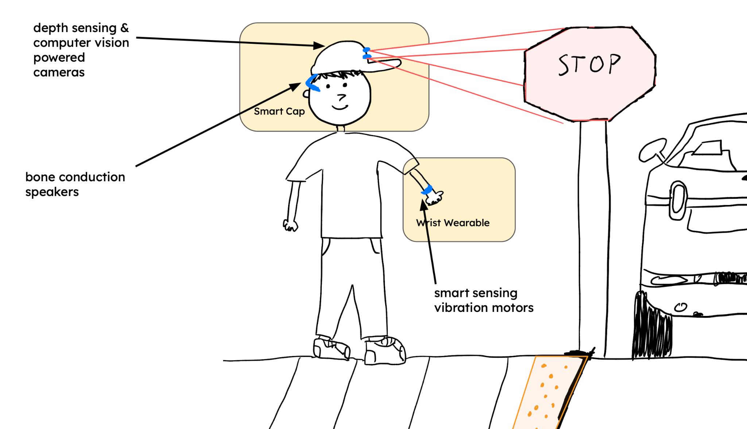
Introduction

Slide 6
Technical Progress

Slide 7



Raspberry Pi Camera Module
Raspberry Pi Camera Module
Bone Conduction Headset
Intelligent Visibility System
Photoresistor
Feeding live video stream
Human speech input
Raspberry Pi 5
Light Emitting Diode Array
Depth Map Processing
Variable Vibration Motors
Object Inquiry Assistant
Bone Conduction Speakers
ESP32 Microcontroller
Text-to-Speech
Wrist Wearable
Smart Cap
Smart System for Visually Impaired

Slide 8
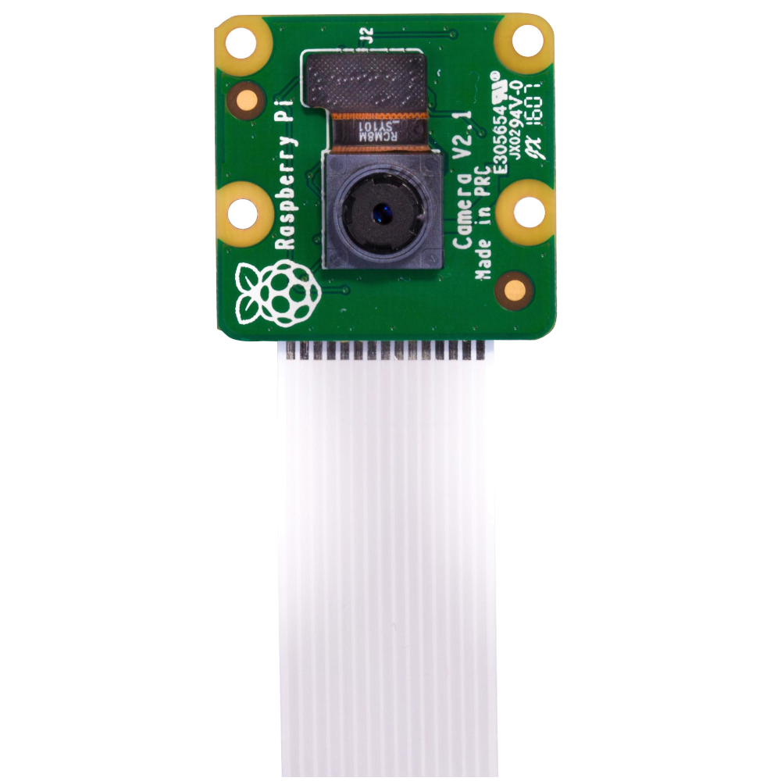
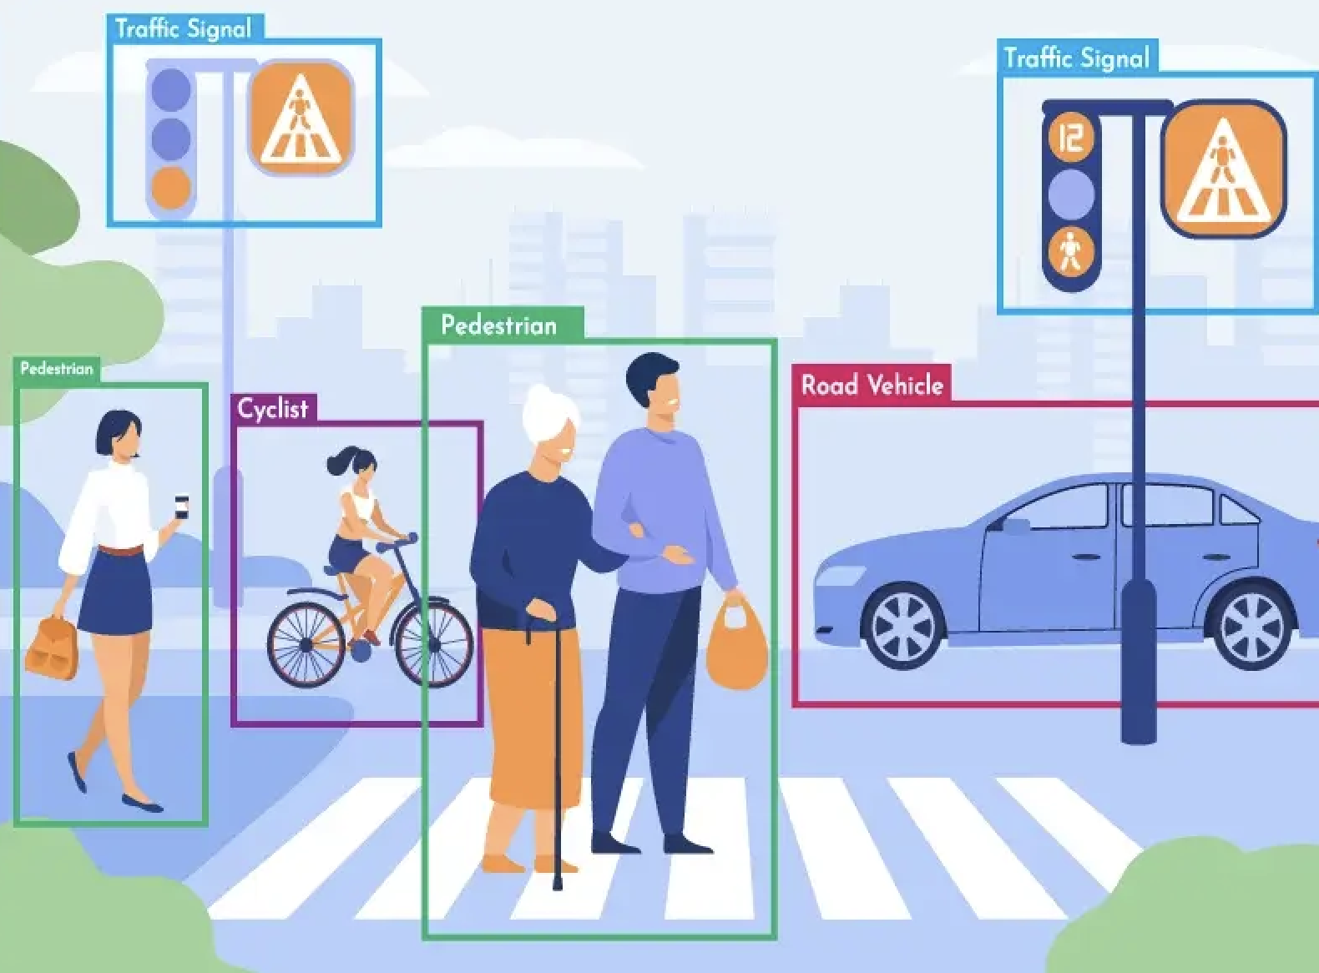
object_detection.py
import cv2
import cvlib as cv
From cvlib.object_detection import YOLO
Combining cv2, cvlib, and YOLO
cv2 - fast image processing and general computer vision related tasks
cvlib - simple high-level library for object detection
YOLO (You Only Look Once) - fast real-time object detection system
We’ve upgraded our previous YOLO model in our first prototype from YOLOv3 to YOLOv8, greatly improving our speed and accuracy of object detection

Slide 9
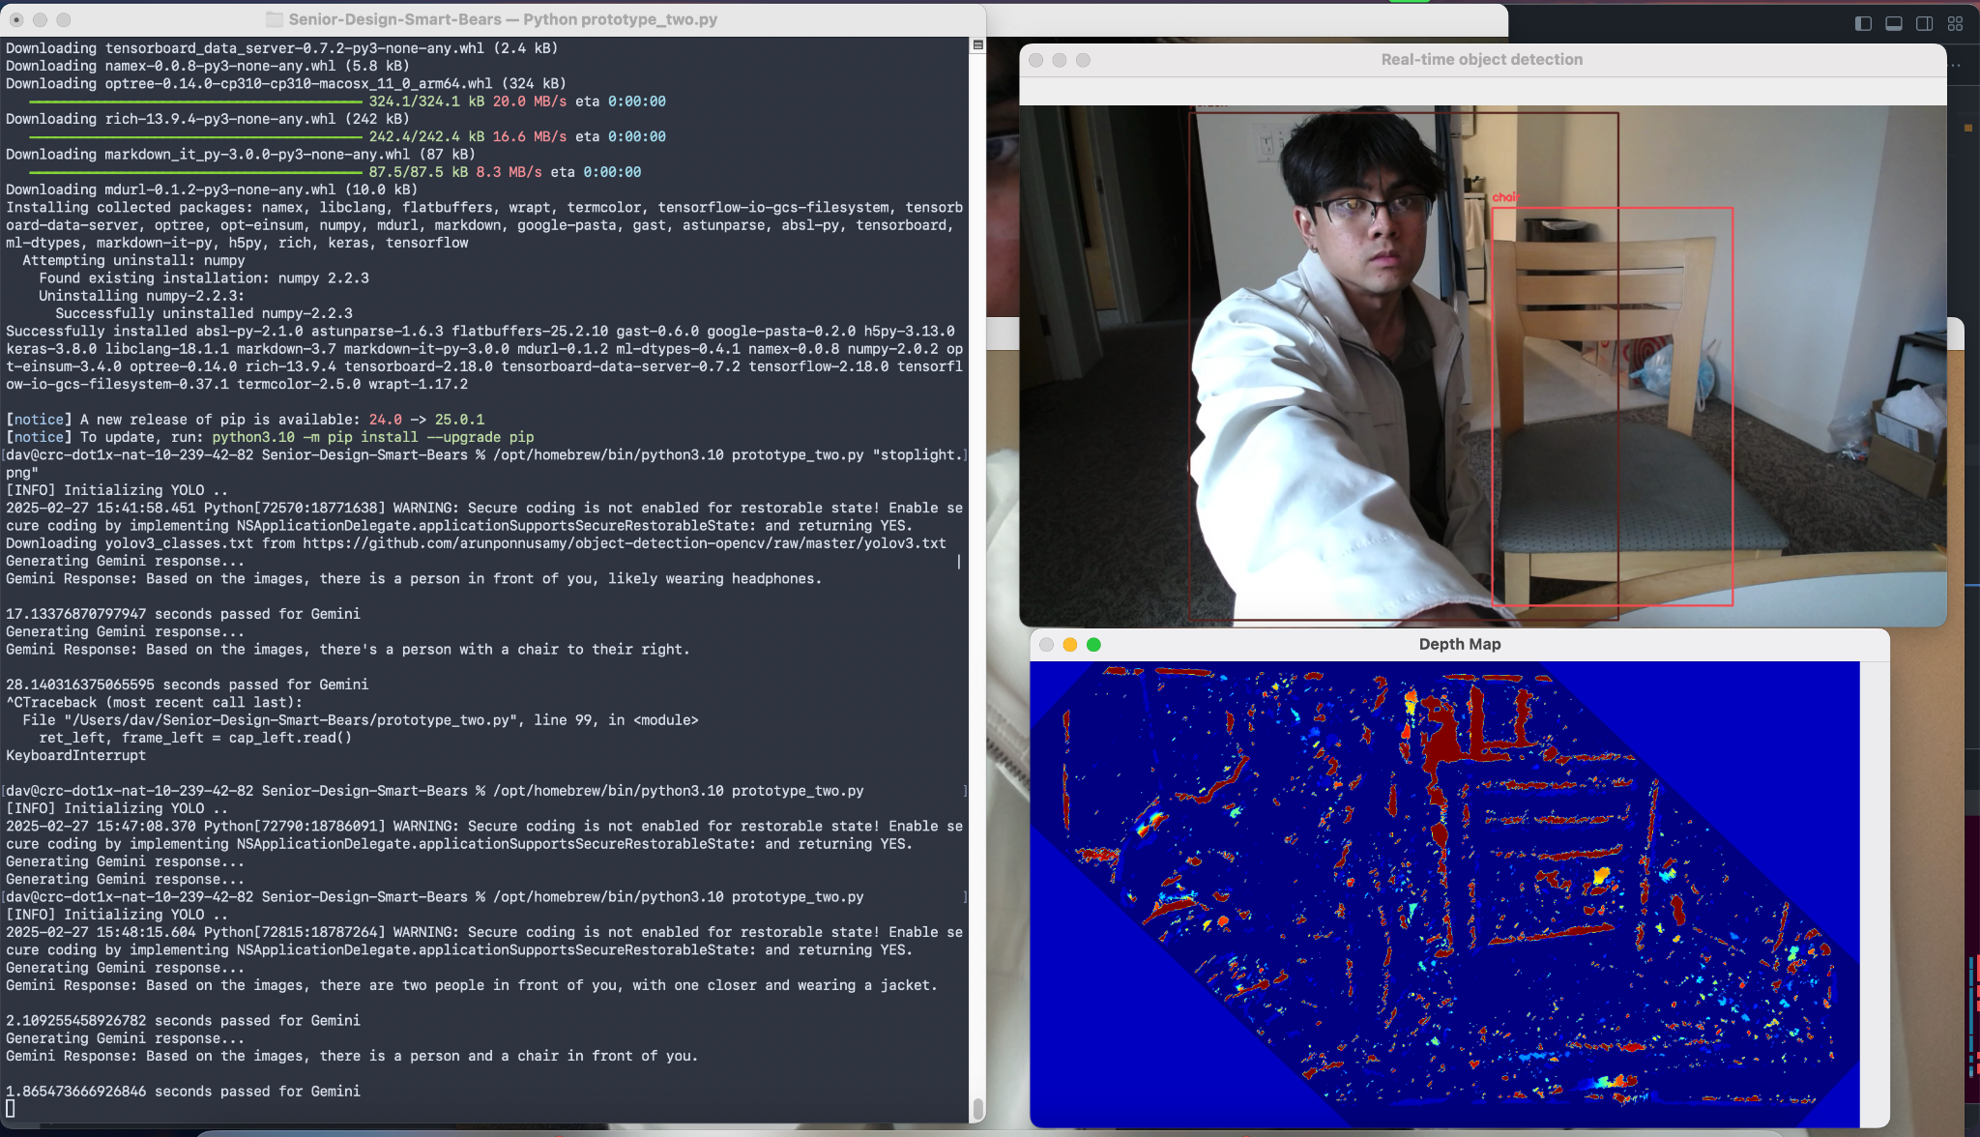

Slide 10

Raspberry Pi Camera Module
Raspberry Pi Camera Module
Bone Conduction Headset
Intelligent Visibility System
Photoresistor
Feeding live video stream
Human speech input
Raspberry Pi 5
Light Emitting Diode Array
Depth Map Processing
Variable Vibration Motors
Object Inquiry Assistant
Bone Conduction Speakers
ESP32 Microcontroller
Text-to-Speech
Wrist Wearable
Smart Cap
Smart System for Visually Impaired

Slide 11
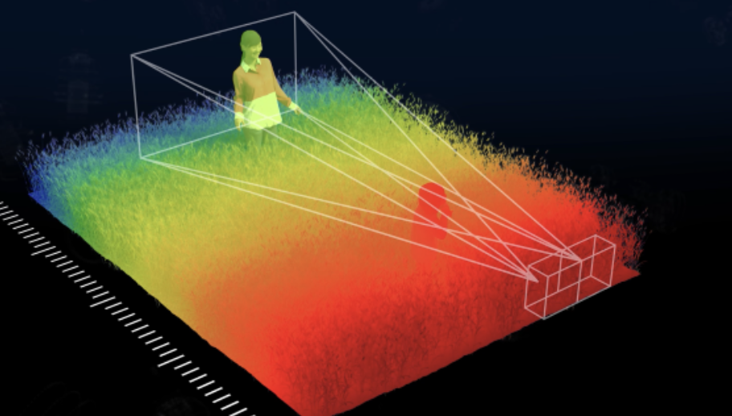
capture_stereo.py
import cv2
import numpy as np
Bringing together OpenCV + numpy python libraries, we developed a comprehensive method to capture images via our RPi Cams and create stereoscopic heatmap snapshots
One of our significant iterations from previous versions of our product—incorporating two cameras to be used simultaneously for powerful distance sensing capabilities

Slide 13

Raspberry Pi Camera Module
Raspberry Pi Camera Module
Bone Conduction Headset
Intelligent Visibility System
Photoresistor
Feeding live video stream
Human speech input
Raspberry Pi 5
Light Emitting Diode Array
Depth Map Processing
Variable Vibration Motors
Object Inquiry Assistant
Bone Conduction Speakers
ESP32 Microcontroller
Text-to-Speech
Wrist Wearable
Smart Cap
Smart System for Visually Impaired

Slide 14

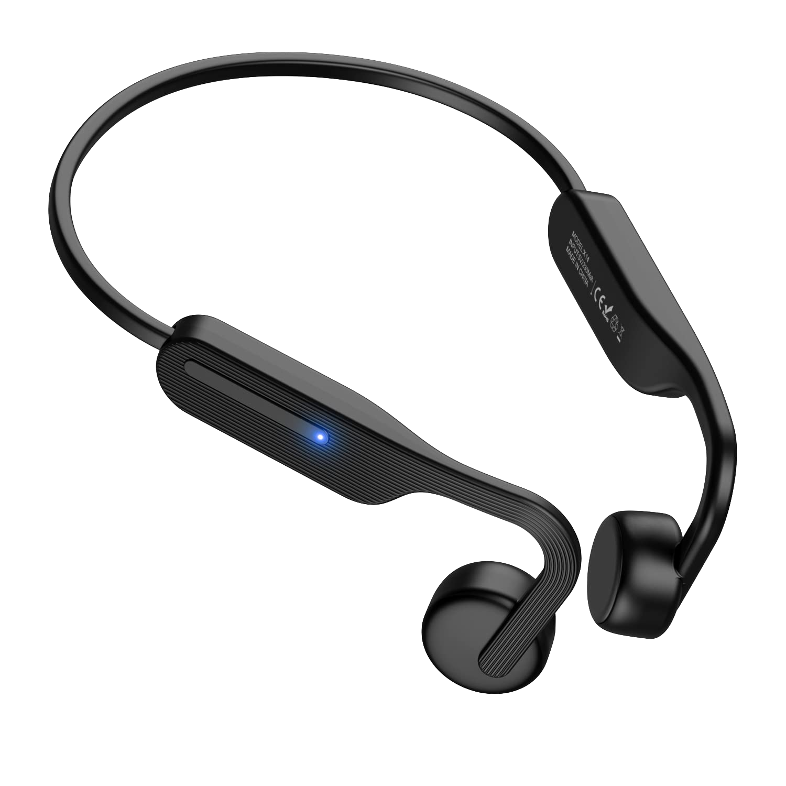
speech.cpp
based on whisperCPP open-source speech-to-text streaming
Implemented LLM-powered speech-to-text application that works seamlessly with our bone conduction Bluetooth headset to transmit user speech into actionable prompts for our Object Inquiry Assistant
Activates on button press and grabs user speech input through the headset at the same time snapshots and CV from the two cameras are processing

Slide 15
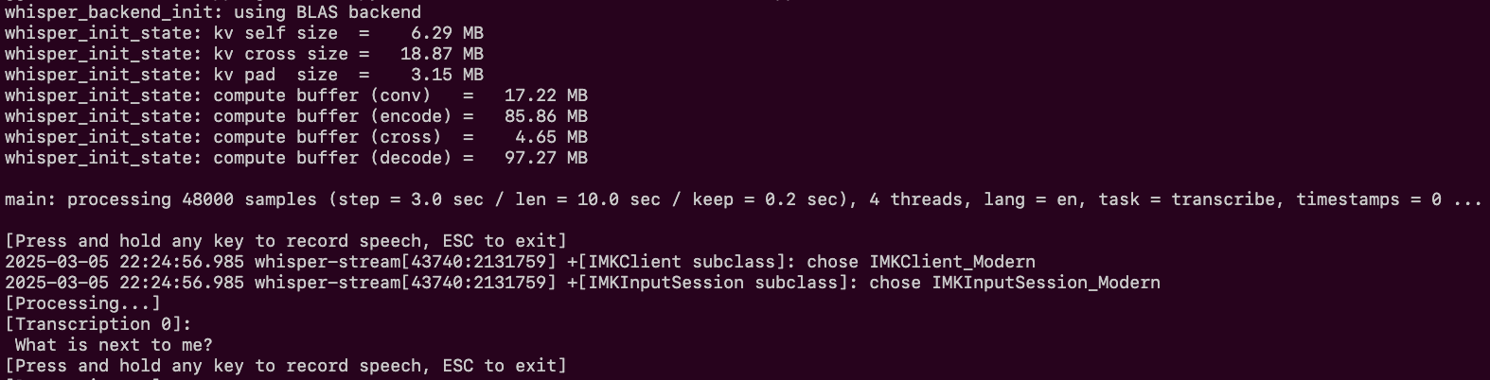
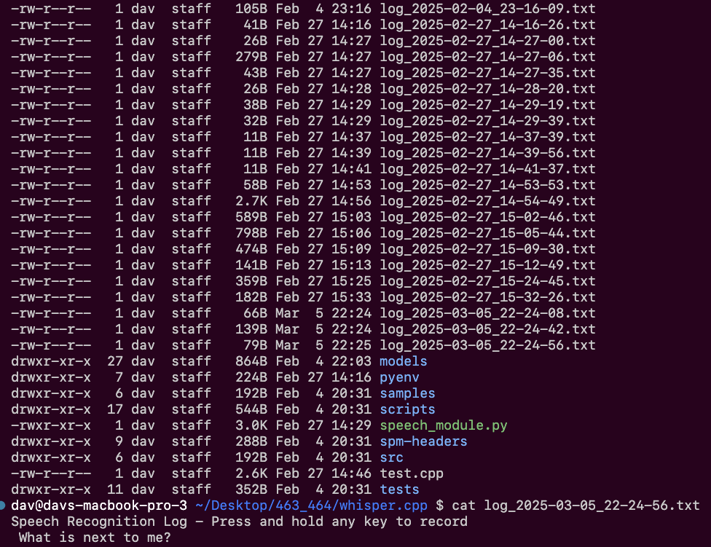
Button-activated + LLM-powered speech-to-text via whisperCPP-modified program
Every speech-to-text action is cached in external log files for prototyping, testing, and demoing

Slide 16

Raspberry Pi Camera Module
Raspberry Pi Camera Module
Bone Conduction Headset
Intelligent Visibility System
Photoresistor
Feeding live video stream
Human speech input
Raspberry Pi 5
Light Emitting Diode Array
Depth Map Processing
Variable Vibration Motors
Object Inquiry Assistant
Bone Conduction Speakers
ESP32 Microcontroller
Text-to-Speech
Wrist Wearable
Smart Cap
Smart System for Visually Impaired

Slide 17


secret_sauce.py
import ollama
import google.generativeai as genai
Integrating image capture and speech recognition inputs into a multimodal large language model (LLM) for comprehensive analysis. Generates informative text responses based on the LLM’s processing.
We’ve experimented with local LLM deployment on Raspberry Pi (LLaVA-7b) and API-based approaches (Google Gemini), evaluating performance and efficiency trade-offs for optimal implementation.

Slide 19
In Progress

Slide 20
Work In Progress
Software-Software Integration
Software-Hardware Integration
Combine audio processing workflows with visual processing workflows
Reduce token footprint of inputs to OIA
Alter video processing to work with Pi and cameras
Allow text-to-speech to work with bluetooth
Add haptic feedback effects based on OIA output
New & Improved Features
Housing and Hardware Selection
Finalize and fabricate housing designs
Select cameras
Select a battery to power the product
Improve latency of OIA
Improve relevance and detail of OIA output
Introduce hardware and software for IVS

Slide 21
Combine Audio and Video Processing
Software-Software
Integration
Reduce Token Footprint of OIA Input
Audio processing (speech-to-text & text-to-speech) and video processing (object detection & depth mapping) work independently with OIA.
However, it has proven difficult to integrate input controlled audio and video processing together.
With this integration, we can contain our entire workflow in one executable.
The OIA is powered by an LLM, so high token queries have led to slow responses.
The main bulk of our queries is from images, so techniques like image resizing or feature extraction can be used to reduce the tokens used.
With this improvement, we will have faster, higher quality responses.

Slide 22
Software-Hardware Integration
Raspberry Pi Cameras
Bluetooth Speaker Text-to-Speech
Haptic Feedback Signals from OIA
Our setup has proven to work with two cameras through a laptop, but some changes may be needed to get it working on the Pi.
This change is needed to make our system portable and practical.
The main output of our system is still in text.
Though we have text-to-speech modules, integrating with the headset is needed to improve the convenience and privacy of our system.
Haptic signals can communicate information very quickly. Though audio is still the main bulk of our system’s output, the use of haptic signals can improve the consumption of information.
To accomplish this, we need to design semantic signals and translate them into code that our haptic motors can understand.

Slide 23
New & Improved Features
Improve OIA Latency
Improve OIA Output
Introduce Hardware and Software for IVS
The OIA is the main performance bottleneck of our system.
Improving our hardware to run LLMs locally or selecting a faster API to call will improve user experience.
We need to experiment with how we prompt the OIA to improve what it outputs to users as this is the main output of our system.
The IVS is an important safety feature for users in low light situations.
Wiring up our LED array and and the sensors to control the LEDs will accomplish this.

Slide 24
Housing/Hardware

Slide 25
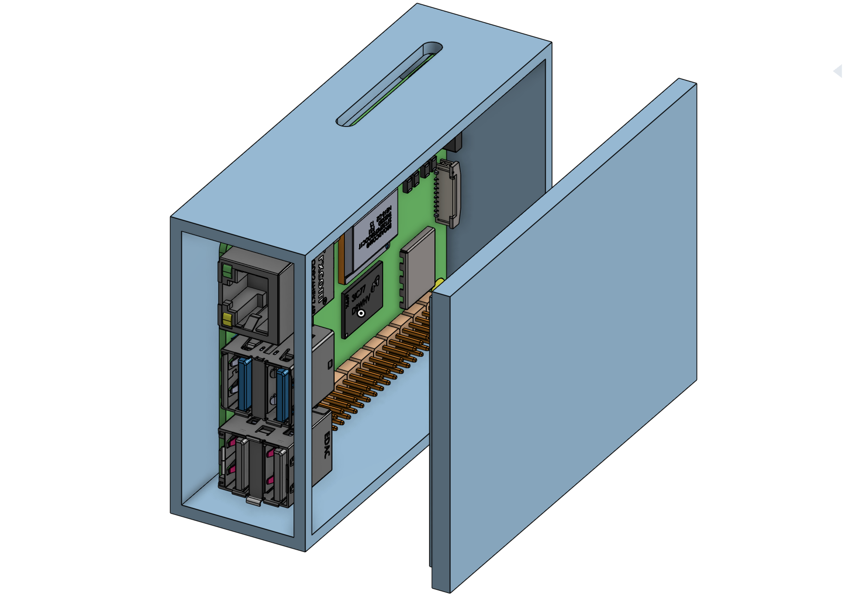
Raspberry Pi Housing

Slide 26
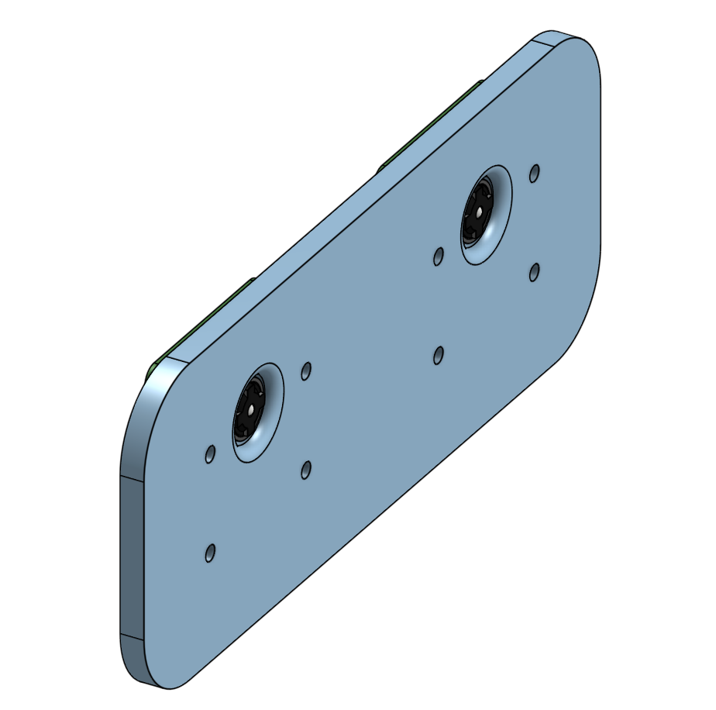
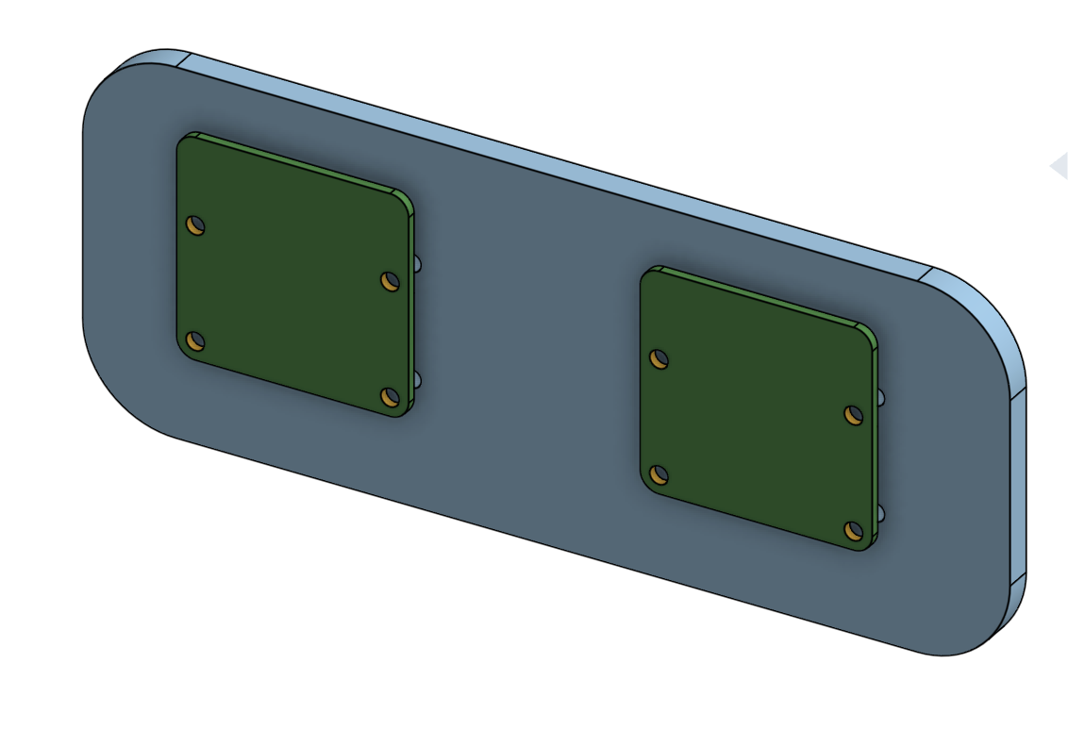
Stereo Camera

Slide 27
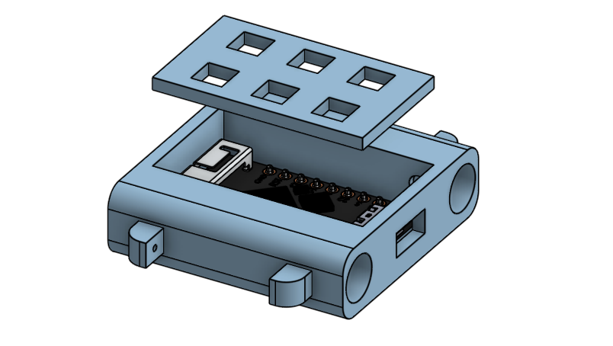
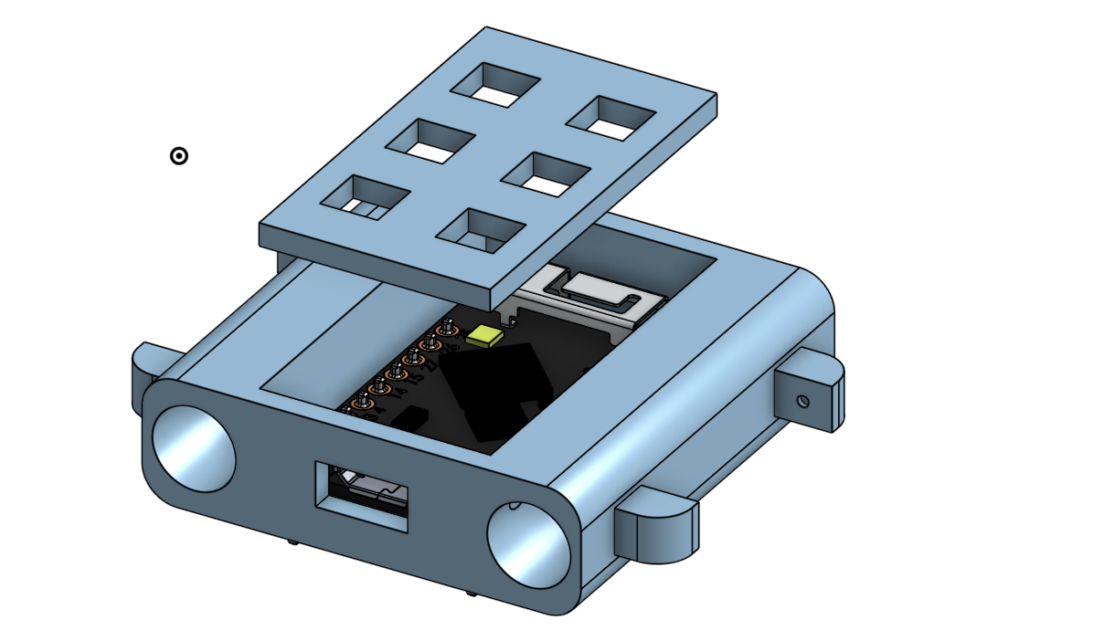
Wrist Housing

Slide 28
Battery
Hardware Components
Cameras
Select and purchase a battery that would give our system a reasonable (> 2 hr) battery life while being rechargeable and portable.
Select and purchase durable, powerful cameras with small footprints such that they can be mounted on the cap.

Slide 29
Milestones

Slide 30
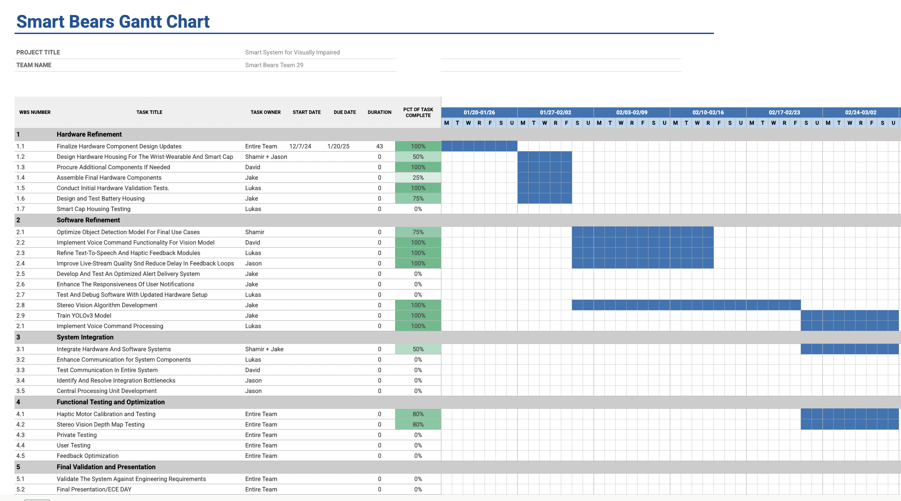

Slide 31
Additional Milestones
Finalize Hardware Validation
Complete testing of all hardware components to ensure functionality and reliability
Develop Optimized Alert Delivery System
Enhance user notifications for better responsiveness and usability
System-Wide Communication Testing
Conduct end-to-end (e2e) communication tests between hardware and software components to ensure seamless integration
Haptic Feedback Optimization
Refine haptic feedback system for improved user experience

Slide 32
Thank You
+
Questions?

